Slide 1


Renovate with Confidence. Your Vision, Our Expertise. Dare to Dream, Renovate with Glee. Your Home, Your Way, Our Know-How.
Kim Metzger, Chris Whitehead, Rakesh Rai, and Sean Cosenza
Notes:
Introduction
In today’s fast-paced environment, efficiency, cost-effectiveness, and seamless project execution are essential for successful home improvement projects. The integration of artificial intelligence (AI) into project management tools can revolutionize how we approach home improvement tasks, from planning to execution. This presentation outlines the rationale for adopting an AI-powered project management tool tailored for home improvement, highlighting its benefits, features, and potential impact on our organization.

Slide 2

Background
Current market landscape
Help fit consumer need
Consumer base/market demand
Problems (costs, time, headaches)
Notes:
Background
Home improvement projects often involve numerous moving parts—scheduling, budgeting, resource allocation, and vendor management. Many homeowners struggle to coordinate these tasks, leading to delays, cost overruns, and unsatisfactory outcomes. An AI-powered project management tool can streamline these processes by providing intelligent solutions to common challenges faced by homeowners and contractors.

Slide 3

Proposed Technology: AI-Powered Home Improvement Project Management Tool
AI-Driven Cost Estimation
Smart Resource Allocation
recommend the most cost-effective options
Resource Analysis Process
Data Collection
Inventory and Supplier Databases
Machine Learning Models for Cost-Effectiveness
Optimal Resource Recommendations
Notes:
AI-Driven Cost Estimation: Utilizing historical data and market trends, the tool can provide accurate cost estimates for materials and labor, helping users budget effectively.
Smart Resource Allocation: The tool can analyze available resources and recommend the most cost-effective options for completing projects, ensuring timely procurement of materials and labor.
For example, the AI-powered tool could leverage a combination of data sources, predictive algorithms, and machine learning models. Here’s how it might work in practice and how it could bridge a gap for clients:

Slide 4
Bridging a Client Gap
A CENTRAL, CLIENT-FRIENDLY PLATFORM
Transparent, Informed Decision-Making:
offering transparent cost breakdowns
End-to-End Project Optimization
tool bridges these steps into one streamlined system
Adaptive Learning
tool would continually learn from each project
Notes:
One major gap in the home improvement market is the lack of a central, client-friendly platform that seamlessly manages both the planning and procurement phases. Many clients feel overwhelmed by navigating multiple vendors, comparing fluctuating costs, and balancing quality with budget constraints.
Here’s how this tool could fill this void:
Transparent, Informed Decision-Making: By offering transparent cost breakdowns and recommendations backed by real-time data, the tool empowers clients to make confident decisions without extensive industry knowledge. They wouldn’t need to rely solely on contractors’ input or spend hours researching options.
End-to-End Project Optimization: Clients typically struggle with the disjointed nature of home improvement projects, often requiring separate tools for budgeting, sourcing, and scheduling. This tool bridges these steps into one streamlined system. By aligning budgeting, supplier selection, and scheduling, it reduces friction and creates a more cohesive, predictable experience.
Adaptive Learning: Since the tool would continually learn from each project, it could provide increasingly personalized recommendations for repeat clients, identifying their preferences and cost-saving patterns, which fosters loyalty and a sense of partnership.
By filling this gap, the tool could become an essential resource for clients, simplifying complex decisions, providing cost transparency, and reducing stress—all key value propositions in the home improvement industry.

Slide 5
Website Demo.
https://homeglowpsu.github.io/homeglow/
Dare to Dream, Renovate with Glee. Your Home, Your Way, Our Know-How.
Notes:
By filling this gap, the tool could become an essential resource for clients, simplifying complex decisions, providing cost transparency, and reducing stress—all key value propositions in the home improvement industry.
Project Planning and Scheduling: AI algorithms can optimize project timelines, adjusting for delays and resource availability, which helps in maintaining project momentum.
Augmented Reality (AR) Integration: Users can visualize their projects using AR technology, allowing them to see how proposed changes will look in real-time, enhancing decision-making.
Invoicing and Payment Tracking: The tool simplifies financial management by generating invoices and tracking payments, which reduces administrative overhead and improves cash flow management. Benefits of Implementation
Increased Efficiency: By automating scheduling and resource management, the tool reduces the time spent on administrative tasks, allowing project managers to focus on execution.
Cost Savings: With accurate cost estimations and optimized resource allocation, homeowners can avoid unexpected expenses and make informed financial decisions.
Enhanced Decision-Making: AI-driven insights and AR capabilities empower users to make better design choices, leading to higher satisfaction with project outcomes.
Improved Communication: The tool facilitates collaboration between homeowners, contractors, and suppliers, ensuring everyone is aligned on project goals and timelines.

Slide 6
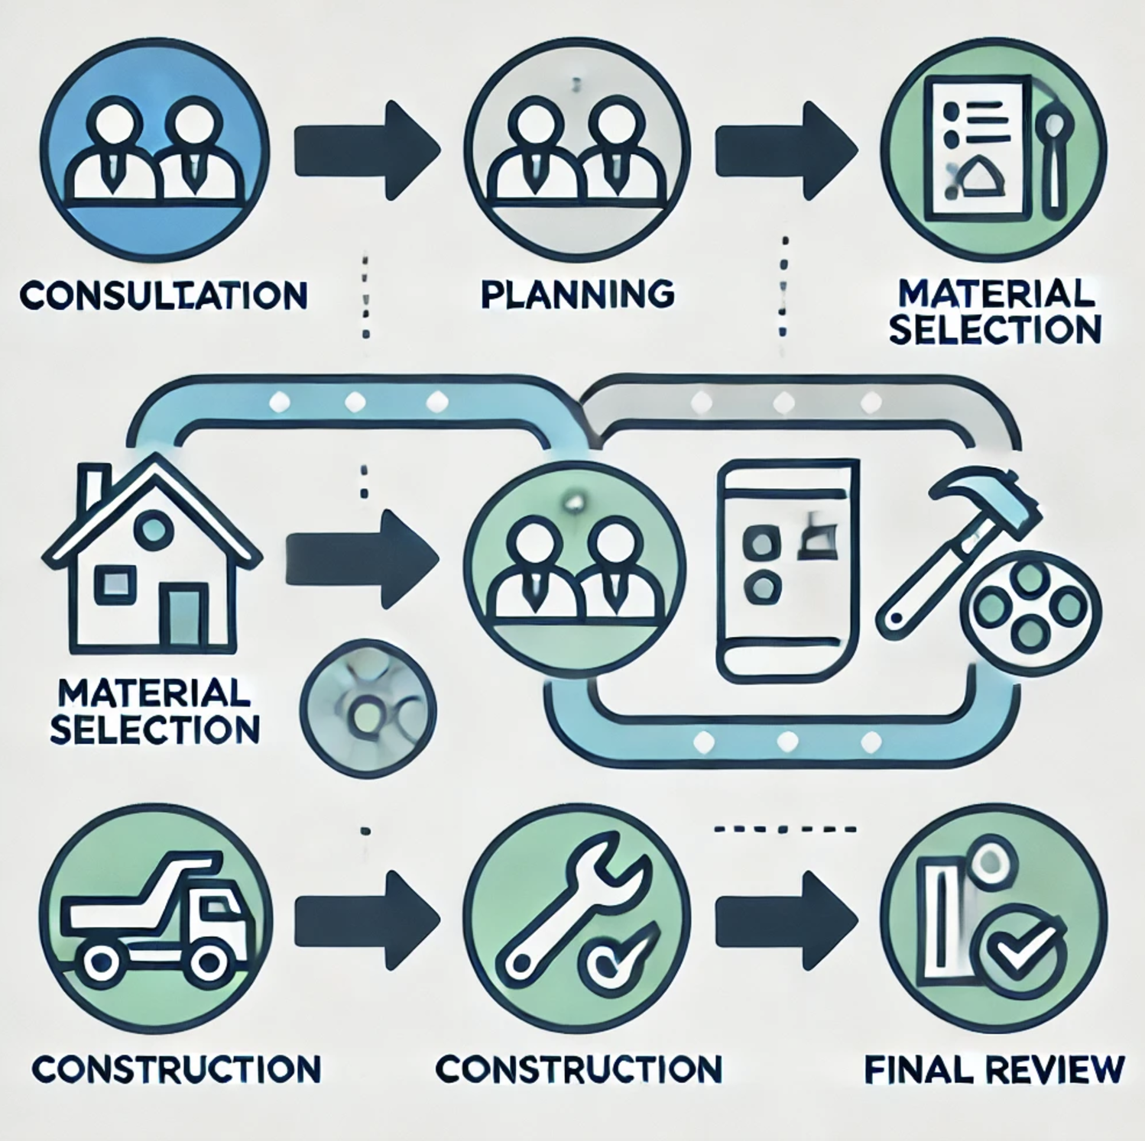
Process Flow
Five basic steps of home renovation service
Consultation.
Planning
Material Selection
Construction
Final review
Notes:
To further illustrate the potential of an AI-powered project management tool, consider a hypothetical case study where a homeowner embarks on a kitchen renovation. Using the tool, the homeowner receives a detailed budget estimate that incorporates costs for materials and labor, schedules the project phases based on contractor availability, and visualizes the renovation through AR. The result is a completed project within budget and ahead of schedule, showcasing the tool's effectiveness.

Slide 7
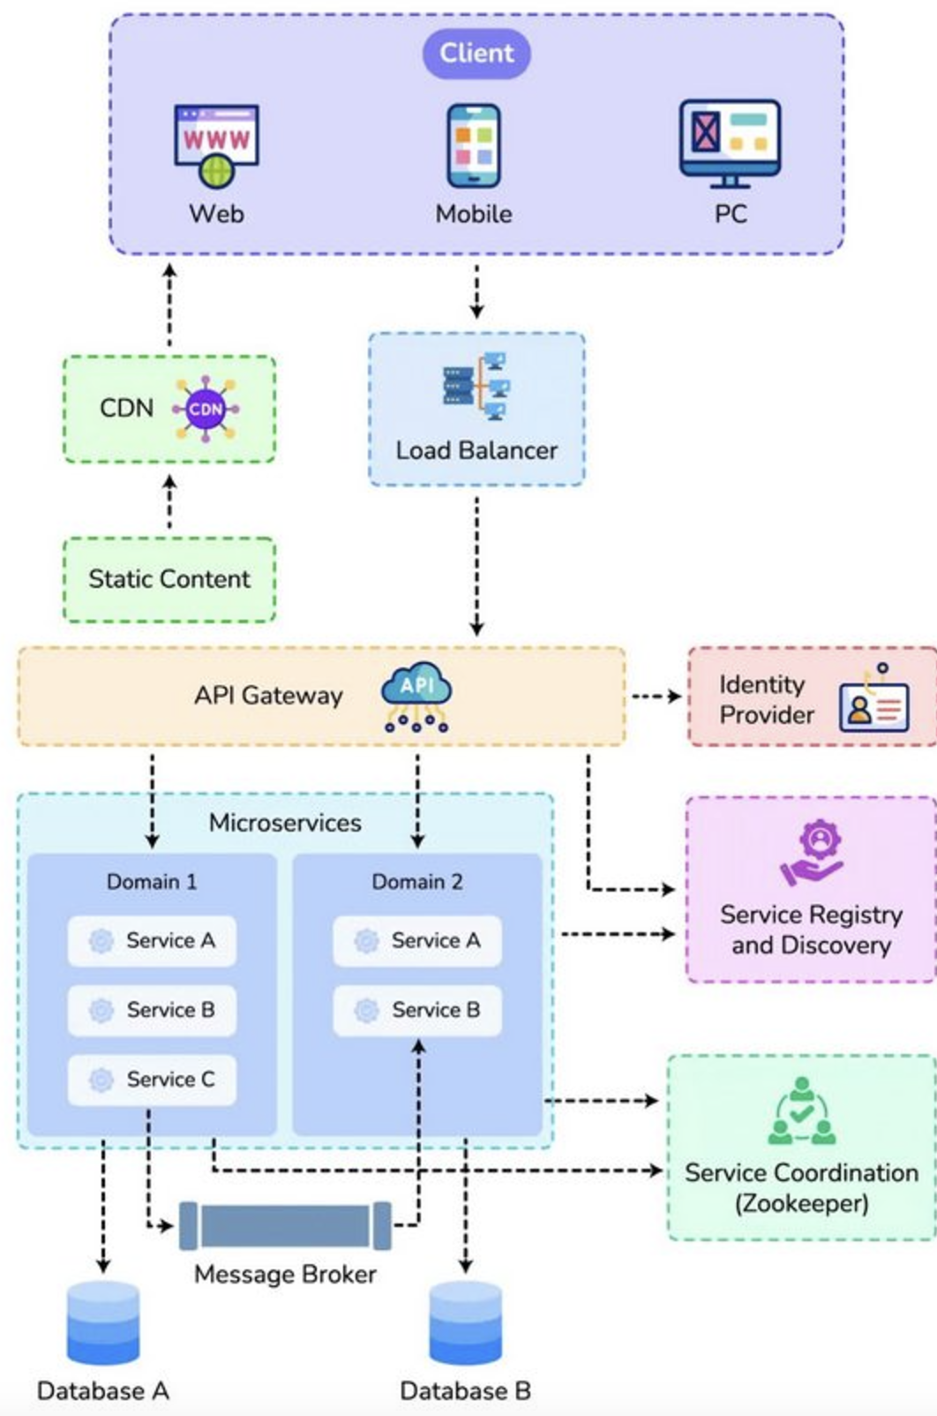
System design and S/w architecture
Microservices architecture
Browser Based
Mobile
Scalable
Service Oriented Architecture
Notes:
Coupled with anything else…

Slide 8
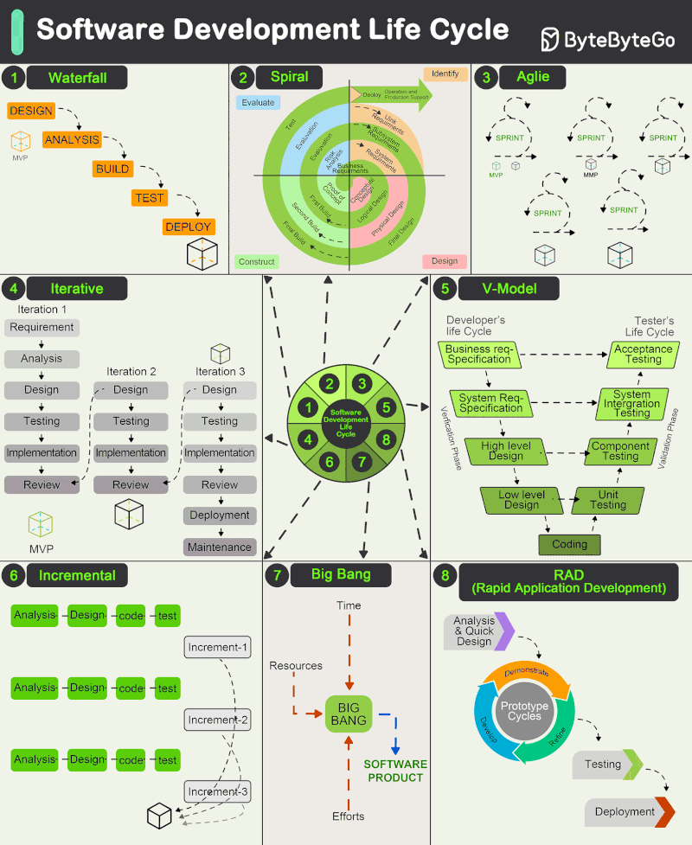
SDLC
Source: ByteByteGo’s Post on LinkedIn

Slide 9
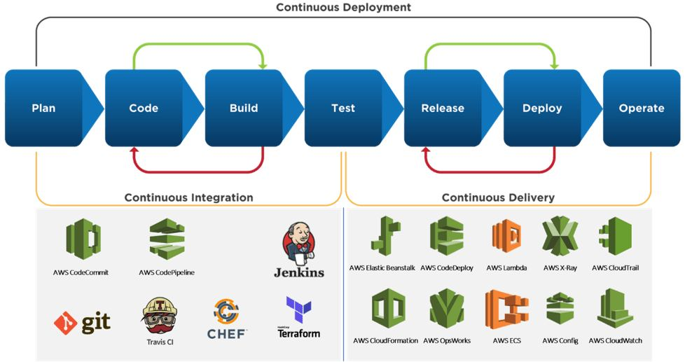
Deployment process

Slide 10
Strategic Alignment with Organizational Goals
Understanding Stakeholder Priorities
Enhancing the customer experience, reducing delays, and supporting future scalability (Forrester, 2024)
Business Outcomes
Enhanced Customer Experience
Personalized Recommendations for New Homebuyers
Collaborations with Local Stakeholders for Real-Time Data
Increased Efficiency
Cost Optimization
Notes:
Understanding Stakeholder Priorities:
Project HomeGlow’s leadership prioritizes customer satisfaction, operational efficiency, and scalable growth.
The AI tool aligns with these priorities by enhancing the customer experience, reducing delays, and supporting future scalability (Forrester, 2024).
Business Outcomes:
Enhanced Customer Experience: Personalized project recommendations and real-time updates on progress.
Personalized Recommendations for New Homebuyers
Tailored Renovation Guides for Relocating Homebuyers: The tool could cater specifically to homebuyers relocating to an unfamiliar area by providing a “local renovation guide.” This guide would offer insights into typical design preferences, material durability for local climate conditions, and styles that match the local aesthetic.
Material Sourcing and Cost Forecasts: Leveraging regional and historical home data, the tool could even forecast the costs associated with different materials or design choices. For example, if slate roofing is popular in a historic North Carolina neighborhood but costly, the system could alert users to budget-friendly alternatives that maintain the aesthetic without sacrificing quality.
Collaborations with Local Stakeholders for Real-Time Data
Partnerships with HOAs and Planning Departments: Collaborations with HOAs and town planning departments would allow the system to provide real-time updates on local regulations, renovation restrictions, or incentives. This ensures homeowners are not only aware of the local style but also of any specific restrictions they must adhere to, which could be crucial in historically preserved areas.
Real Estate Insights on Neighborhood Profiles: By pulling in data from real estate listings and previous renovation costs in the area, the tool could offer newcomers valuable information on neighborhood profiles, including what types of renovations are standard or highly valued in each area.
Increased Efficiency: Automated scheduling and resource allocation to eliminate bottlenecks.
Cost Optimization: Predictive analytics to identify potential cost overruns before they occur.

Slide 11

Financial Justification
ROI Analysis
Cost Savings
Increased Revenue
Forrester TEI Framework
estimate financial impact and risk mitigation (Forrester, 2024)
Success Stories
Example from Forrester
Notes:
ROI Analysis:
Cost Savings: Automating scheduling and resource management can reduce administrative overhead by 25%.
Increased Revenue: Enhanced customer satisfaction can drive repeat business, contributing an estimated 15% increase in yearly sales.
Forrester TEI Framework: This structured methodology will be used to estimate financial impact and risk mitigation (Forrester, 2024).
Success Stories:
Example from Forrester: AI tools in energy management saved 12% in energy usage for a Canadian firm. Similarly, AI in home improvement can yield significant time and cost savings (Forrester, 2024).
Example from Forrester: Autonomous Workplace Assistants (AWAs) and TuringBots demonstrate how AI can optimize workflows by analyzing data and automating key processes (Forrester, 2024).
Proposed Use Case: Project HomeGlow will adopt an AI-powered platform to:
Assist homeowners in planning projects by offering tailored recommendations based on preferences, budgets, and timelines.
Manage contractor assignments and scheduling for seamless service delivery.
Predict project timelines and potential risks, enabling proactive adjustments.

Slide 12

outcomes
Market Trends and Opportunities: (Forrester, 2024)
TEI Methodology: (Forrester, 2024)
Cost Analysis: (Forrester, 2024)
Mitigation Strategies: (Forrester, 2024)
Stakeholder Engagement: (Forrester, 2024)
Notes:
We will acknowledge potential constraints in our proposal, such as budget limitations, resistance to change, and the need for staff training. By applying Forrester’s guidance on risk assessment and mitigation strategies, we will outline how to overcome these challenges.
Risk Assessment
A. Identifying Risks
Discuss potential risks associated with the technology implementation (e.g., integration challenges, employee resistance, and data security concerns).
B. Mitigation Strategies
Propose strategies to mitigate identified risks, such as training programs and phased implementation (Forrester, 2024).
Structuring a strong business case, benefits, cost, flexibility, risk. “Forrester page 6.”
“traditional cost/benefit models may not apply”
“required metrics around customer engagement, agility, and efficiency/cost reduction are the same as for established technologies, the data and reference points may not be available”
“Technology leaders will have to use assumptions in their business case, a concept that may not sit well with data-focused leaders”

Slide 13

Implementation Plan
Notes:
Step-by-Step Roadmap:
Phase 1: Pilot Program: Deploy the AI tool in a single region to test its capabilities and gather user feedback.
Phase 2: Full Rollout: Scale deployment across all service areas, integrating customer and contractor feedback.
Phase 3: Continuous Improvement: Use AI analytics to refine processes and enhance functionality over time.
Stakeholder Engagement:
Key stakeholders include project managers, contractors, IT teams, and customer service representatives.
Establish regular feedback loops to ensure alignment and adoption.
Metrics for Success:
Reduction in project delays by 20%.
Increase in customer satisfaction scores by 15%.
Achievement of 10% cost savings in operational expenses within the first year.

Slide 14
Board Priorities
Don’t skip the introductions
Know the board’s priorities — really know them
Focus on business outcomes
Think like a CFO
Share success stories
Notes:
Do we have a board
We can make their priorities
What their priorities are
The article talks about difference in traditional business goals, board priorities and emerging tech
Convicing a CFO
Non traditional ROI’s such as cutting cost increasing efficiency for some techs to use as a pitch, customer satisfaction
Benefits, costs, flexibility and risks
Now presenting,
Introductions is a great place to state your assumptions. Boards priorities,
Outcomes and CFO: Refer to page 8 of Forrester.
The Boards regardless care about money - a big financial component – he is saying think like an owner
Ancillary revenue streams
For as much as he is referring to the technology part, he wants us to think of how we are integrating technology into business, - CFO’s directors, etc. execs, want to see metrics- Rakesh could show up front costs vs our expenses to show profit per job

